Slide 1
Life “Modes” in Social Media
Fatih Kursat Ozenc (CMU), Shelly D. Farnham (Yahoo!)
CHI 2011
December 30, 2011
Hyewon Lim

Slide 2
Outline
Introduction
Background
Methodology
Study Results
Emerging Themes
Design Recommendations
Conclusion
Discussion

Slide 3
Introduction (1/2)
People increasingly use social media to connect to others from different areas of their lives (esp. social networks)
“One identity, and one social context, fits all”
Problematic assumptions in their implicit models of social organization
We may easily observe the richness of diverse roles people play across different social contexts
Misalignment between the sharing controls of social networks and users’ roles and social contexts leads to awkward and inappropriate sharing

Slide 4
Introduction (2/2)
We explore how to leverage natural models of social organization from people’s lives
To improve their experiences of social media streams
Performed a design research project to examine
how people might best
(a) organize their online content
(b) transition between different areas of their lives online
(c) focus their sharing and consuming of online content within these areas

Slide 5
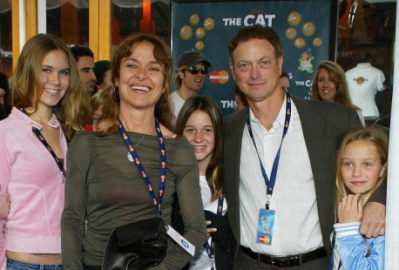
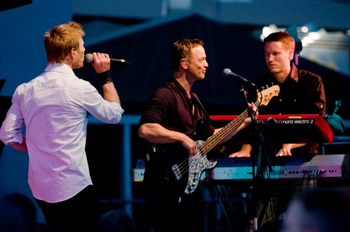
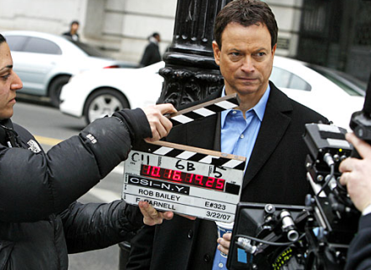
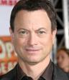
Background (1/5)
Faceted identity
A person with a faceted identity performs different aspects of identity depending on social context
Identity is formed and reinforced through these social role enactments
Past research
The degree of identity faceting varies depending on the individual
A few common life facets
Other more idiosyncratic facets
Notes:
우리는 일관된 personality를 가졌다고 생각하지만, 개인의 행동은 social situation에 따라 달라진다.

Slide 6
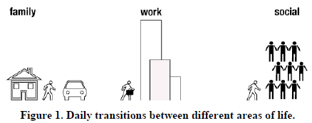
Background (2/5)
Segmentation and transitions
Boundary model of work-home transitions (Nippert-eng[21])
People vary in their levels of integration and segmentation across areas of life
Other people, products, and activities help the person to manage transitions across boundaries
Work/family border theory (Clark[6])
Spotlights the role of people, things and schedules as border-keepers
Focused on the daily micro-transitions (Ashforth et al.[1])
Across work, home, and third places
Notes:
Fig 1: 이 논문에서 하고자 하는 것.
사람들이 온라인에서 life facet들과 그 것들 간의 변화(transition)를 잘 관리하게 하려는 것.

Slide 7
Background (3/5)
Sharing and consuming content online
Online contexts
Freed from the constraints of time and location
Openness across different areas of users’ lives
Openness
Increases boundary permeability
Spill over of information
Networks do not easily enable specifying sharing by type of connection
Social networks do not sufficiently consider the multifaceted nature of self and life modes in their design

Slide 8
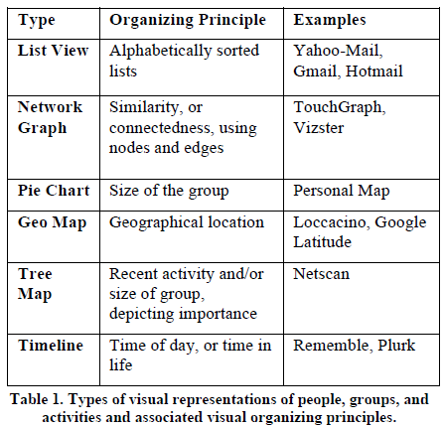
Background (4/5)
Representations of people, activities and groups
Experimental visualizations with diverse organizing principles

Slide 9
Background (5/5)
Four exploratory design themes
Organize by facets
How may we help users organize their online worlds based on common primary areas of life?
Rituals for transitions
How do people navigate between their different areas of lives?
Hoe might this translate to online situations?
Focused sharing and consuming
How might we help users share and consume content with the right people in the right context?
Natural representations of facets
How do users naturally mentally model areas of their lives?
What are natural and appealing visual representations of facets and groups?

Slide 10
Methodology
In-depth, two-hour interviews
Life mapping activity
How people naturally mentally model different areas of their lives
Need validation session
How they incorporate communication technologies to support them
Visual metaphors ranking activity
How we might improve their online experiences of managing their social media streams

Slide 11
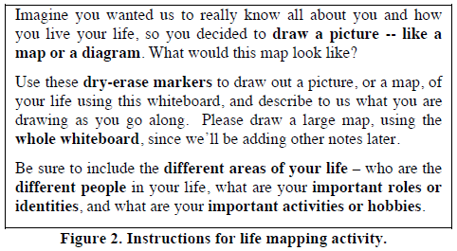
Methodology Life Mapping Activity
Life mapping [Farnham03]
Draw out pictures or diagrams of important areas of your lives
Instructed participants to describe
how they used communication technologies to support different areas of their lives
how they maintained their life segmentation
how they transitioned between areas of life

Slide 12
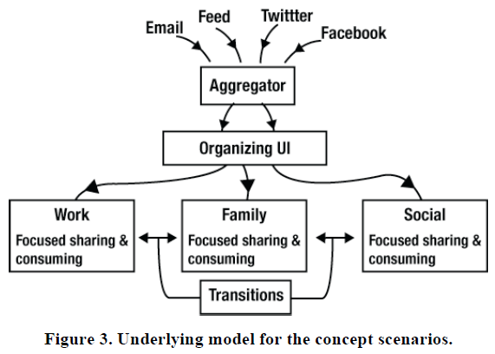
Methodology Need Validation Session
Generate eleven concept scenarios
On organizing contacts, focused sharing, focused consuming, and transitions
Based on a general underlying model

Slide 13
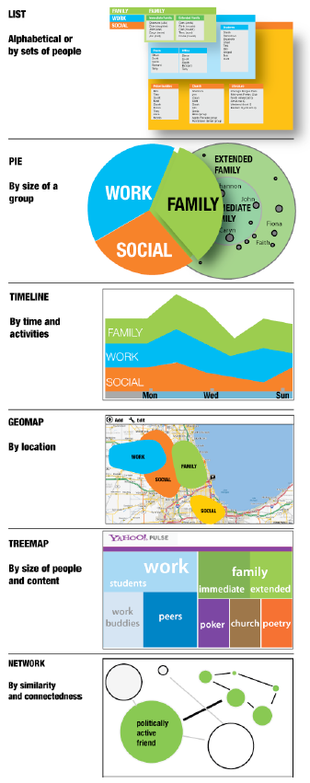
Methodology Visual Representations
Select six visual representations
Embedded them into the concept scenarios
Participants rank them

Slide 14
Study Results
Qualitative study
To seek out participants who were likely to be involved in more than one life facet and could provide meaningful feedback on concept scenarios that explore how to help people manage life facets online
Questionnaire
Extroversion
I make new friends easily
I am skilled in handling social situations
Life faceting
I have many different sides of me, and the side I show depends on the social situation
I prefer to keep different parts of my life separate

Slide 15
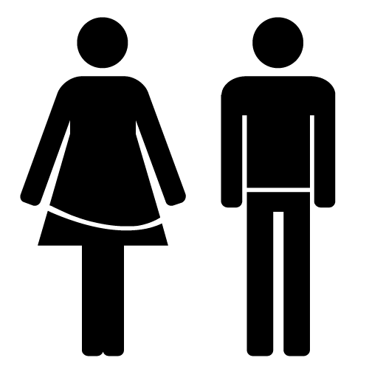
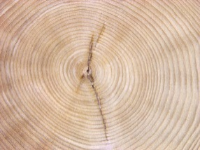
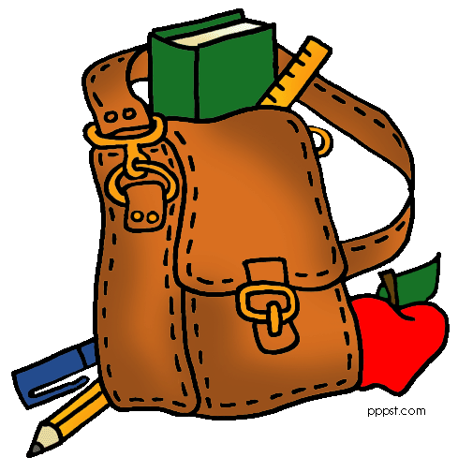
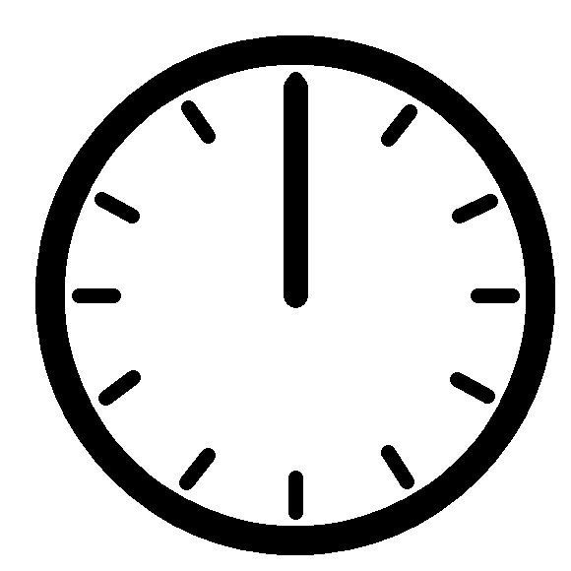
Study Results
16 Participants
44%
56%
37
3
6
8

Slide 16
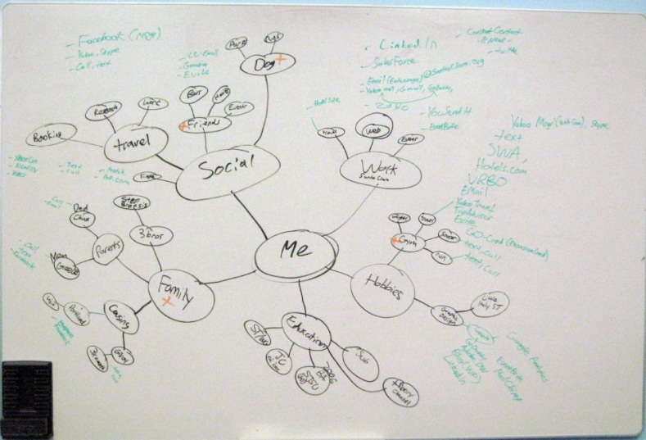
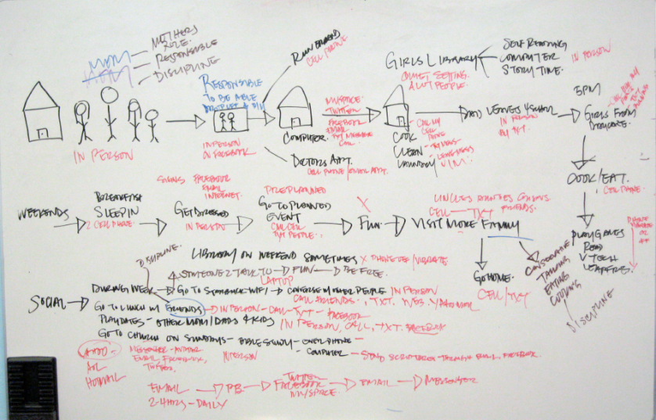
Study Results Life Mapping Activity
Most of the participants drew one of two types of maps for modeling their lives
Social meme map
Timeline map

Slide 17
Study Results Life Mapping Activity
Social meme maps
Drawn by 9 out of 16
7 first drew me in the middle
Social
Work
Me
Family
Hobbies
Notes:
9명 중에 7명이 제일 첫 노드로 한 가운데에 ‘Me’를 그림.
그리고 Me에 이어지는 important primary meme node로 대부분이 family, work, social(혹은 friends/personal)을 그렸으며, 이것이 삶의 카테고리를 나타내는 가장 일반적인 primary node로 보여짐.
16명 중 15명이 family를 가장 중요한 카테고리로 뽑았음.
Primary node에서 연결되는 secondary node로는 좀 더 개인적으로 넘어감. 예를 들면 특정 그룹(soccer team), 중요한 사람(mom), 취미(sewing), 이벤트(BBQ) 같은 것들.
특이하게도 몇몇 사람은 computer나 Facebook을 primary or secondary node로 꼽기도 했음.
이 후 third level부터는 node가 굉장히 개인에 특화되어 나타남.

Slide 18
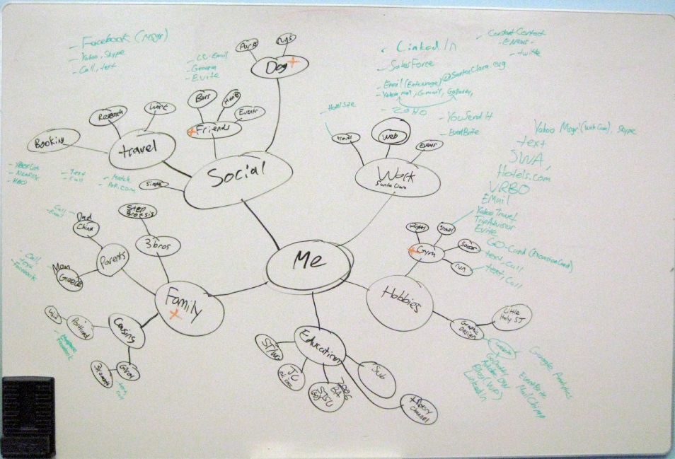
Study Results Life Mapping Activity
Social meme maps

Slide 19
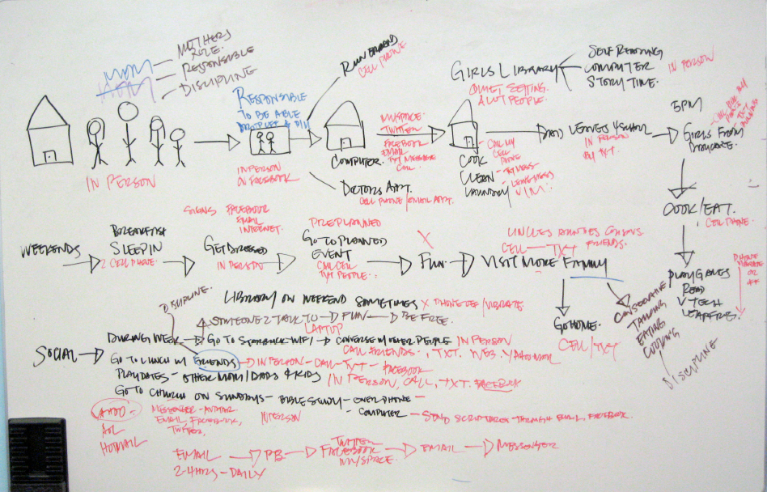
Study Results Life Mapping Activity
Timeline maps
More collage flavor than the social meme maps
Drawn by 5 out of 16
2: long-term view
3: daily view
Notes:
Social meme map 보다 콜라주의 느낌이다. -> 한 map안에 다양한 그림들(사람, 취미, 장소 등을 표현하는)이 나타난다.
흥미로운 점은, daily timeline을 그림 사람들은 학부모인 주부였는데, 이들의 timeline model을 보면, 그들의 가족들의 daily schedule을 유지하기 위해 요구되는 활동들이 중심이 되어있음.

Slide 20

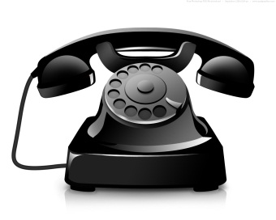
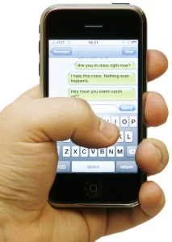
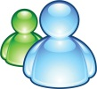

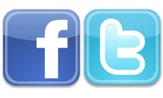
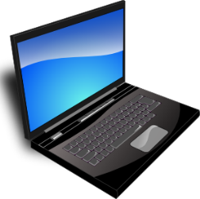
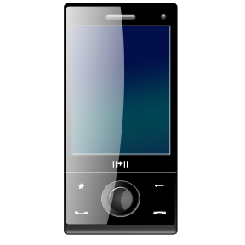
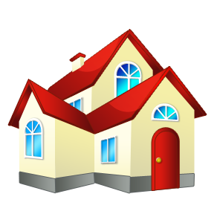
Study Results Communication Practices
Participants wrote down the communication technologies they used for each area or node with different colored markers

Slide 21
Study Results Communication Practices
Chose communication channels based on closeness
The closer a person was to the self, the more they used a mix of all communication channels
Mobile phones
For aggregating across different communication channels
For hyper coordination
Texting
Preferred as it is practical, more immediate, and less interruptive
Notes:
Mobile phone -> dominant tool

Slide 22
Study Results Communication Practices
Chose communication channels based on different areas of their lives
At work
Primarily used email and voice phone (e.g., Skype)
Most do not use Facebook while connecting to their coworkers
Within the family
Diverse communication practices
Phone calls, texting, email, and social networks
Preferences depended on
whether family members were part of their immediate or extended family
whether they were tech-savvy
whether they were the same generation

Slide 23
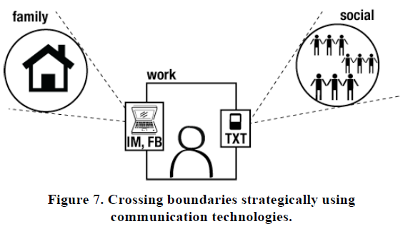
Study Results Communication Practices
Boundary management with communication channels
When crossing boundaries they used less interruptive channels
If they did not want to communicate across boundaries, they simply cut off access to other contexts by turning off their devices and accounts

Slide 24
Study Results Segmenting Areas of Life
Level of segmentation = avg 4.7
Depends on a number of factors
Job type, personality, cultural differences, …
100% of participants segmented their email
At least one work, one personal, and one junk email (, personal business)
Used avoidance strategies to manage their online segmentation
1 = extremely integrated life faces
extremely segmented life faces = 10
Notes:
Avg 4.7 & 각 extreme에 한 명씩 있었고, 실험자들이 1~10안에서 다양한 분포를 했음.
-> 예를 들면, 아내와 함께 그룹 활동을 하는 뮤지션 남성은 work, family, social 이 분리되지 않음.

Slide 25
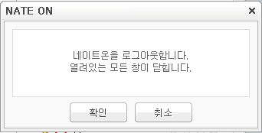
Study Results Transitions
Change ‘modes’
Mode was active at any one time depended on participants’ schedules, locations, and the task of the moments
Transitions from one area of life to another
Most often concurrent with external transitions
Some participants had rituals that facilitated changing modes
Online transitions
Often concurrent with the offline world behaviors, or
Work-home transition without any physical movement
Notes:
Rituals -> 아침에 학교 가기 전에 꼭 샤워를 한다거나,
누구를 만나기 전에 커피를 마시며 생각하는 시간을 갖는다거나…
Online transitions:
w/o의 경우-> 폴더를 닫거나, 새로운 어플리케이션을 켠다거나, 어떤 기기를 꺼버린다거나…

Slide 26
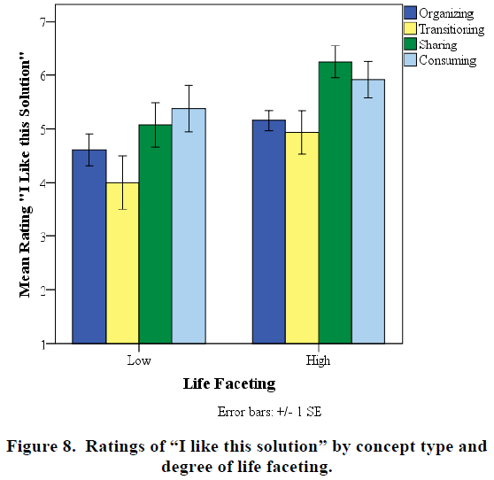
Study Results Need Validation Session
Compare participant ratings of scenarios
They want dynamic and real-time maps crafted for sharing and consuming
Notes:
Paired samples t-test.
Focused sharing을 organizing, transition scenario 보다 선호
Focused consuming을 transition 보다 선호
Organizing과 transitioning간에는 선호의 큰 차이가 없었음.
Life faceting이 높을수록 focused sharing 시나리오를 중요하게 생각하는 경향이 있음.
대신 organizing에는 큰 관심이 없…
가장 중요하다고 생각하는 시나리오는 sharing concept인데, 사람들은 social spam에 대해 우려하는 점이 많음.
-> facebook 같은 데에서 filtering content같은 컨셉들을 좋아하는 듯.
그리고 중요하다고 생각되는 사람들이나 관련있다고 생각되는 사람들하고만 컨텐츠를 나누고 싶어함.
그래서! 다이나믹하고 실시간인 map들을 얻고 싶어한다는 것!

Slide 27
Study Results Need Validation Session
In organizing scenario
Manually organized content
Have a strong feeling of control
Need to invest a lot of time and effort
Automatically organized content
Let the system do the work
Lose the feeling of control
Fear missing relevant people and content
Participants ranked views
Prioritized and showed important people and content
Favoring the tree map view
Also the list view for its familiarity
Favored concepts that showed holistic views of their people and groups

Slide 28
Emerging Themes
“Modes” of the self
Changing modes had a more positive connotation than did changing identity facets
Focused sharing vs. privacy
People have too many ‘friends’ and are overwhelmed by all the online content
Privacy paradox
Privacy settings may be badly designed
Focused sharing
“which groups do you want to share with”
Mobile me as social aggregator
Future of social media is decreasingly desktop-based, and increasingly mobile and contextual
Notes:
Modes of the self
-> facet이 변화한다는 것 보다는 mode가 변화한다는 말을 더 편하게 생각했다.
어떤 사람은, 분명히 다양한 facet들을 보였음에도 불구하고, ‘항상 일관된 사람임’을 주장하기도 했음.

Slide 29
Design Recommendations
Think holistically
Prioritize focused sharing scenarios
Organize sharing by people and life modes
Primary modes: Work, Family, Social
Relative to the self: Importance
Prioritize mobile as aggregator and facilitator
Balance agency
Provide tools for transitioning between life modes
Notes:
1. Think holistically
2. Prioritize focused sharing scenarios
복잡해지는 네트워크와 boundary 경계가 희미해지게 하는 openness 사이에서, privacy도 고려해야 한다.
3. Organize sharing by people and life modes
Primary modes: Work, Family, Social
이 모드들이 일반적으로 공통된 모드들이지만, 개개인마다 그 내용들은 다르다. 이 모드들에 대해 organizing, sharing, transitioning을 고려해야한다.
Relative to the self: Importance
‘상대적으로’ 중요한 사람들을 표현해 주는 것이 필요하다.
Prioritize mobile as aggregator and facilitator
Balance agency
Provide tools for transitioning between life modes
디자인 할 때, 사람들의 ritual이나 external signal들(어디로 이동하는지, 옷을 갈아 입었는지, 음악을 재생하는지 등)을 반영할 수 있음 좋다.

Slide 30
Conclusion
People with higher levels of faceted identity have the problem of organizing, sharing, and consuming online
Feedback from concept scenarios
Two strong needs: focused sharing, focused consuming
We recommend designers and researchers
Think about the user’s communication ecology holistically
Consider life ‘modes’ as one of the organizing principles
Prioritize focused sharing and the mobile medium
Incorporate cues and signals when designing for transitions

Slide 31
Discussion
Strong point
생각을 실험으로
새로운 관점
연구에 반영하면 좋겠다
Weak point
Session: Facebook 어딜봐서?
“16명” vs. “심도 깊은”
반영하고는 싶은데 쉽지 않아 보임

